Slide 1
Word2Vec: Natural Language Processing
Notes:
Word2Vec: Natural Language Processing
Introduction
My presentation today is far from perfect, but it is what I could manage to put together under the circumstances and I hope you enjoy it. I am thrilled to have an opportunity to use my data science knowledge still and to share it with my colleagues at DAIDS.
Please accept this PowerPoint as a very high-level guide to Natural Language Programming (NLP) as best I can describe it at the moment.
This technology is fundamental for any application that analyzes written documents and understanding it even at a high level is decisive, so please try to enjoy it.
And remember that I hope that this short presentation sets off a passion for you to learn more about data science and NLP in particular.
Thank you

Slide 2
Table of Contents
Types of Data
Vector Representation of Data
N-Gram Analysis in NLP
Information Entropy
Negativity and Machine Learning
Examples
Nirvana (or How Looks can be Deceptive)
Notes:
This is the “Table of Contents” for this presentation

Slide 3
Types of Data
Notes:
Types of Data

Slide 4
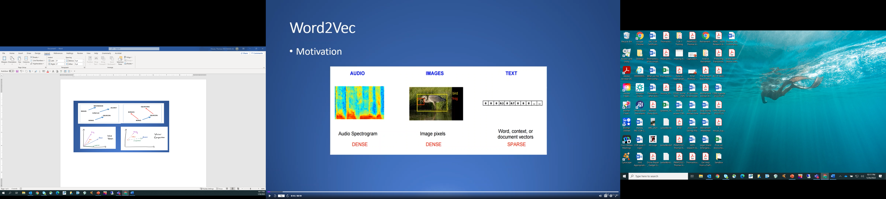
Natural Language Processing : Basics to Advanced with practical implementation using Python, TensorFlow, spaCy, gensim
Fig. 1
Notes:
Audio and image data are referred to as DENSE data audio represent sound bites and images are composed of pixels, but when it comes to text files, the data content is very SPARSE.
So how does one get text data to be DENSE, and why?

Slide 5
Vector Representation of Data
Notes:
Vector Representation of Data

Slide 6
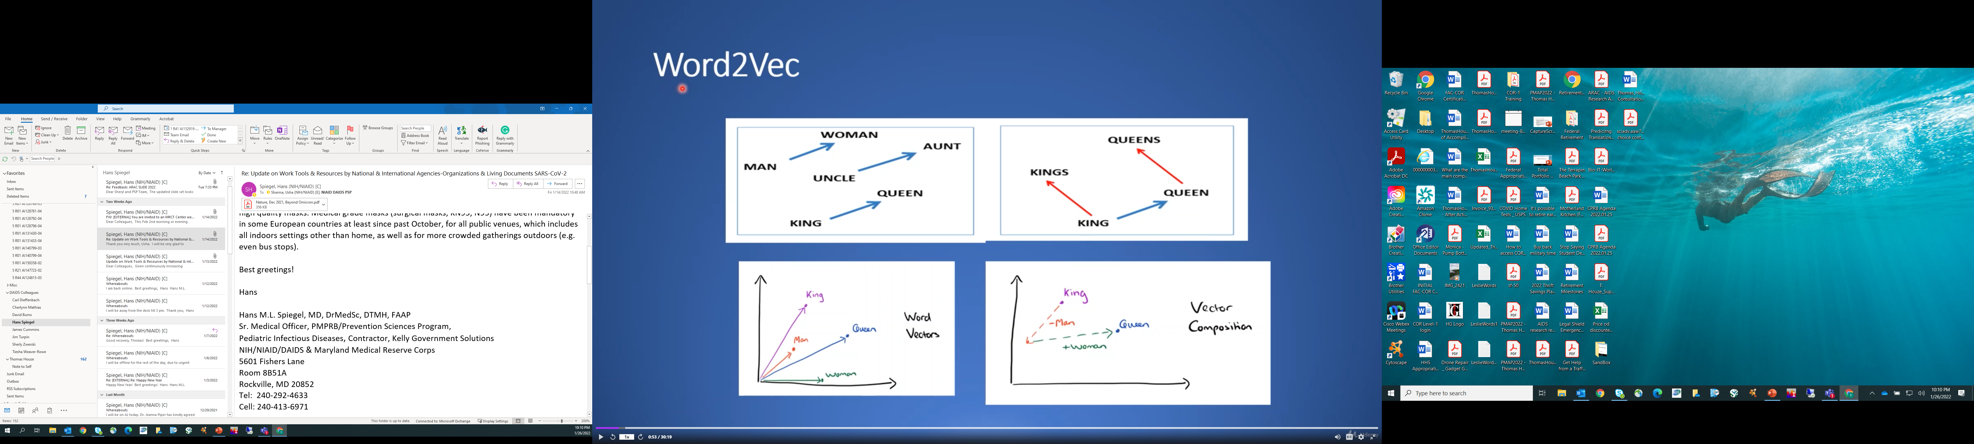
Fig. 2
Word2Vec is an open-source program invented by Google.
A.
D.
C.
B.
Notes:
Word2Vec is an open-source program invented by Google to map words into 3D vector space. For the sake of simplicity, this example will be done in 2D.
In Panel-A, we see how words are placed in a 2D “vector space.”
In Panel-B, we see the vectors for Queen, King, Woman, and Man.
In Panel-C, “Vector Composition” is performed, that is “vector math” to derive a new vector:
First, subtract the vector for Man from the vector for King deriving a “first fixed point” on the 2D map.
Second, add the vector for Women at the first point to derive a “second point” location.
Next, observe that the “second point” is the exact location of the word Queen in Panel-B.
Similarly, in Panel-D, vectors can capture the relationship between the words King and Kings and Queen and Queens and so on.

Slide 7
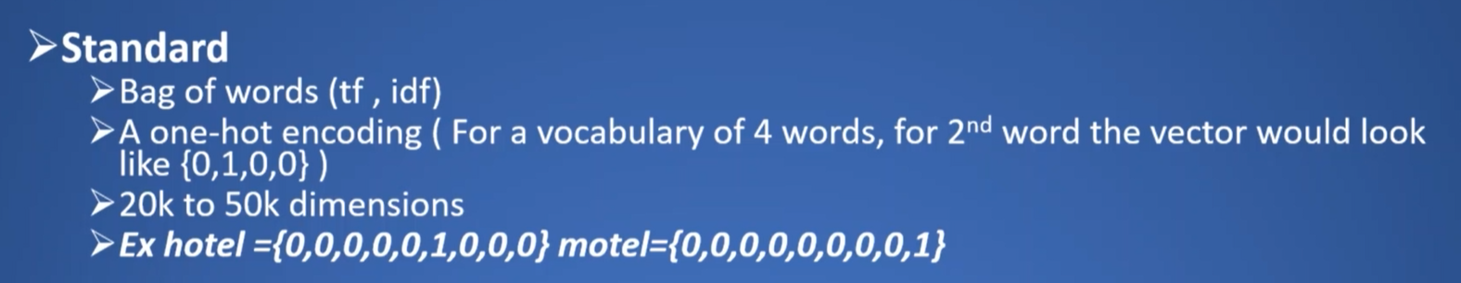
Two examples of the representation of words by Machine Learning (ML)
Fig. 3
Notes:
The first bullet point in Figure 3 shows the standard representation for words using “Bag of Words" such as to create a “Word Cloud” using term frequency.
The second bullet represents machine learning with "one-hot encoding," where with a vocabulary of four words, the second word in the vector created will look like {0,1,0,0} where the “1” is in the second position and for the first word, it will be {1,0,0,0} and in the first position and so on.
In the third bullet, we see that a 20,000- or 50,000-word vocabulary would have a corresponding 20,000 and 50,000 dimensions.
Therefore, the disadvantage of "one-hot encoding" is that you need a dimension for every word in your vocabulary, and it requires considerable dimensions to represent the words.
In the fourth bullet, we see an additional disadvantage of "one-hot encoding" where two words like "hotel" and "motel," though semantically very similar with "one-hot encoding," they have very different vectors; therefore, there is no accounting for "vector space."

Slide 8
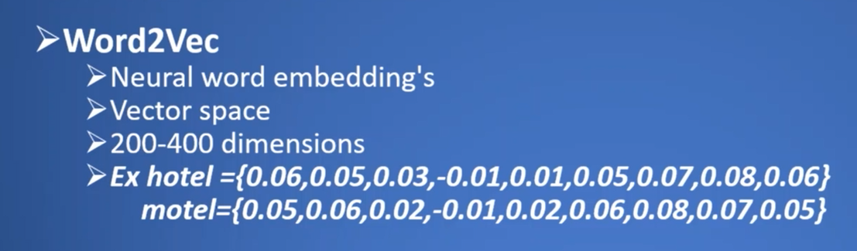
Fig. 4
Notes:
In bullets one-through-three of Figure 4, we introduce Word2Vec, a better machine learning tool representing words in vector space, where the vector space could be in 200-to-400 dimensions as opposed to tens of thousands which is the case; with "one-hot encoding."
In bullet four at the bottom of the slide with Word2Vec, for example, if you have two semantically similar words, like "hotel" and “motel," their values in "vector space" will also be quite similar.
The above means that these words would be mapped to similar locations in "vector space," which means that they would cluster together in a 3D graphical representation, thus showing their similarity from how these words would have been used, that is, their context of use, in the documents used to train the machine learning model.

Slide 9
N-Gram Analysis in NLP
Notes:
N-Gram analysis allows for the Vector Representation of Data

Slide 10
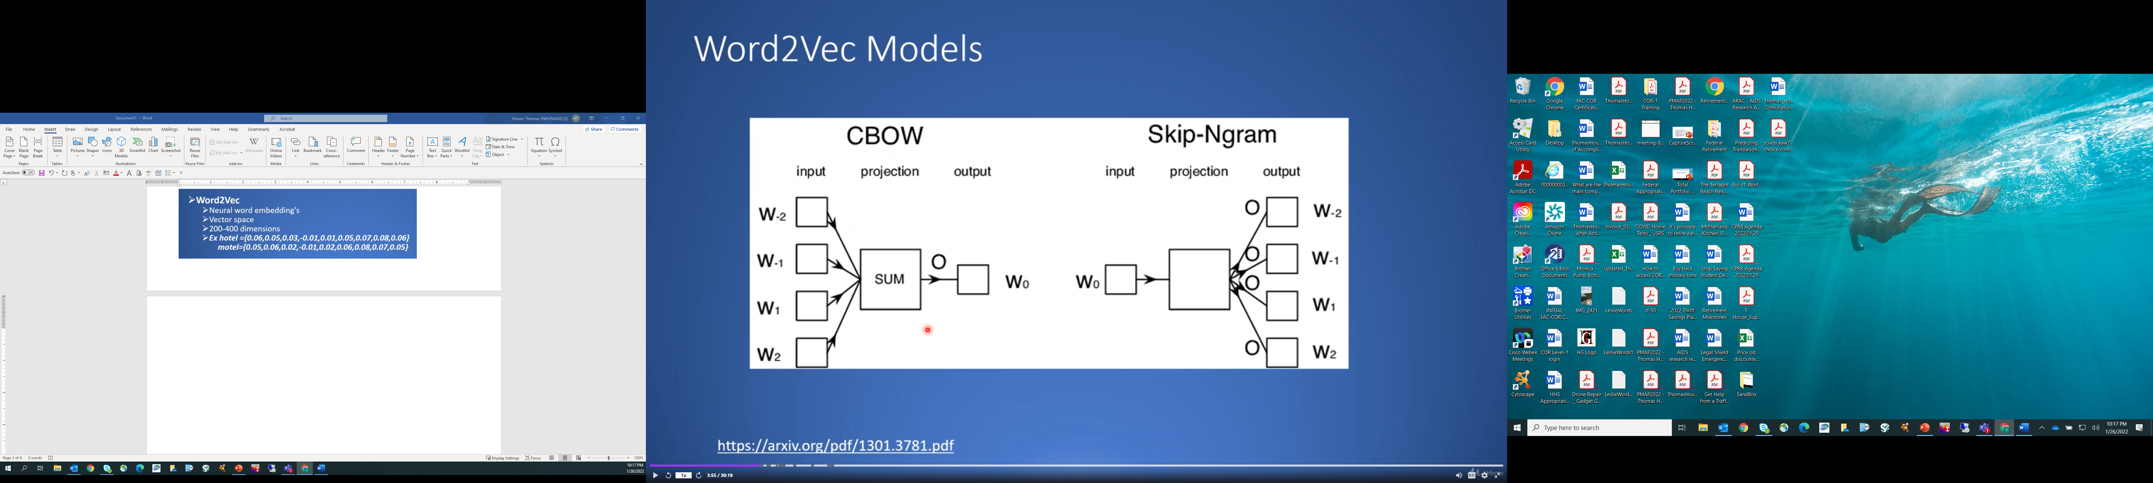
Fig. 5
Word2Vec uses a concept called N-gram analysis
https://arxiv.org/pdf/1301.3781.pdf
Notes:
Word2Vec uses a concept called “N-gram analysis” where the “N” stands for the “size of the window” used in the analysis, which is the number of neighbor words, that is, to the front and behind the input word “W-sub-o” on the left side of Figure-5 that we are interested in analyzing for its meaning.
Here in Figure-5 the word “W-sub-o” to be analyzed is input to a “neural network” which tries to guess the likely identity of the “neighbor words” or “W’s minus two through W two” on the right-hand side of the diagram.

Slide 11
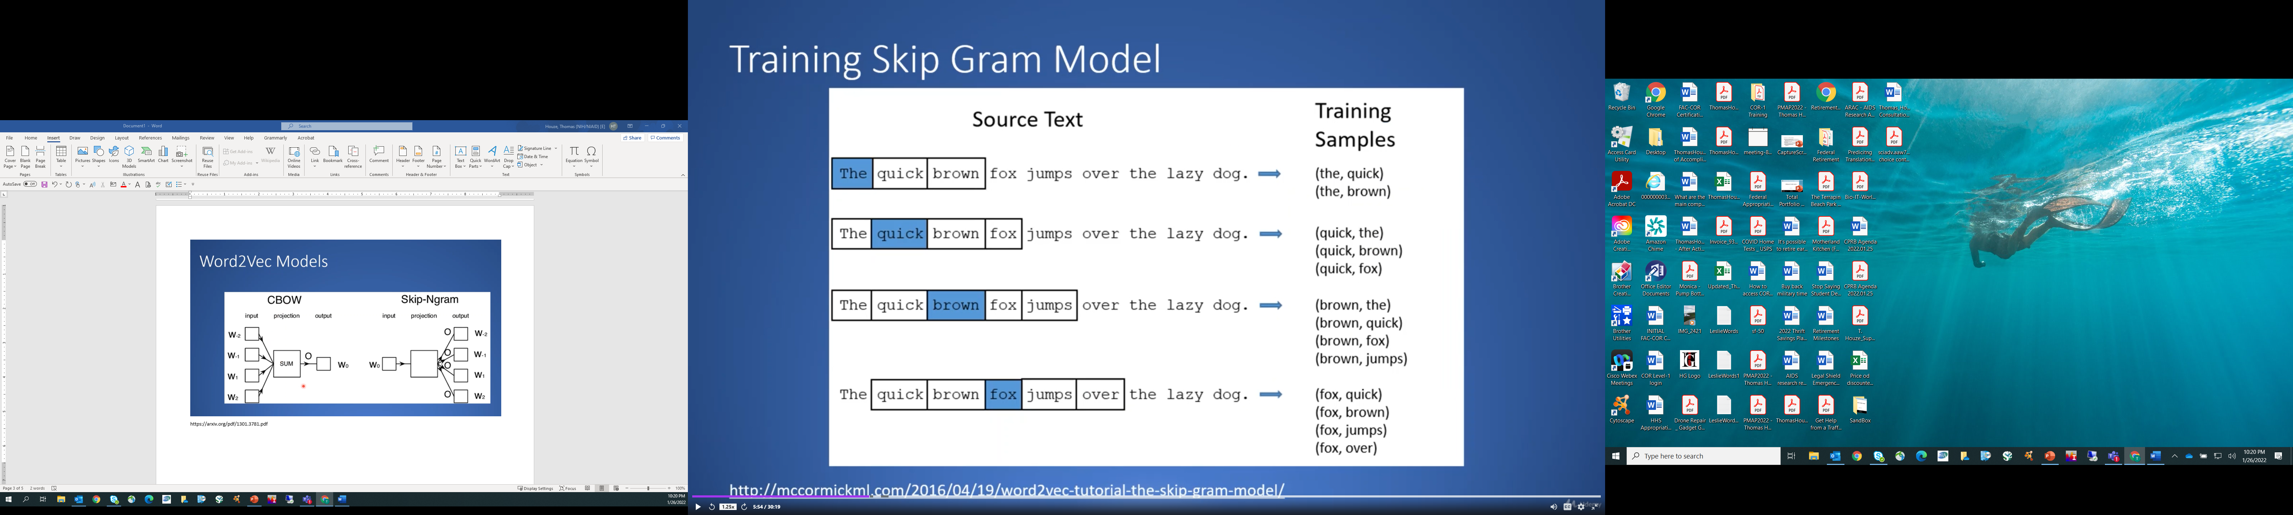
Fig. 6
http://mccormickml.com/2016/04/19/word2vec-tutorial-the-skip-gram-model/
Notes:
In this example, we will consider three of the four cases, the four phrases in Figure-6.
In the first example, in the blue-colored box is the word “The,” which will be the input word to the “Neural Network.”
Therefore the “Neural Network” needs to predict the “W-words” or “neighbor words” to the word “The,” which in this case are most likely the words “quick” or “brown.”
In the next row, if we look at the word “quick” here, the “Neural Network” needs to predict that the neighbor words are “The” “brown” and “fox,”
And, in the last row (row four), if we look at the word “fox,” the “Neural Network” will use a window size of “N equals two words” surrounding the input word “fox” and then predict the neighbor words are “quick” “brown” and “jumps” and “over.”
So, what happened in the first example is it tried to consider two words before and after the input word and since it did not have any words before the word “The” the “Neural Network” had to use the two words after the word “The” in this case to make its prediction of the neighbor words.
And, in the fourth case, the “Neural Network” has two words before and after the input word, so it is considered a window of two words before and after in its prediction in example sentences. This is how Machine Learning models are trained as they go through training data sets creating scoring matrixes of predictive scores based on the sort of experience that it has had outlined above when training the predictive skip-gram model which will be used to analyze the meaning of words in non-training documents.

Slide 12
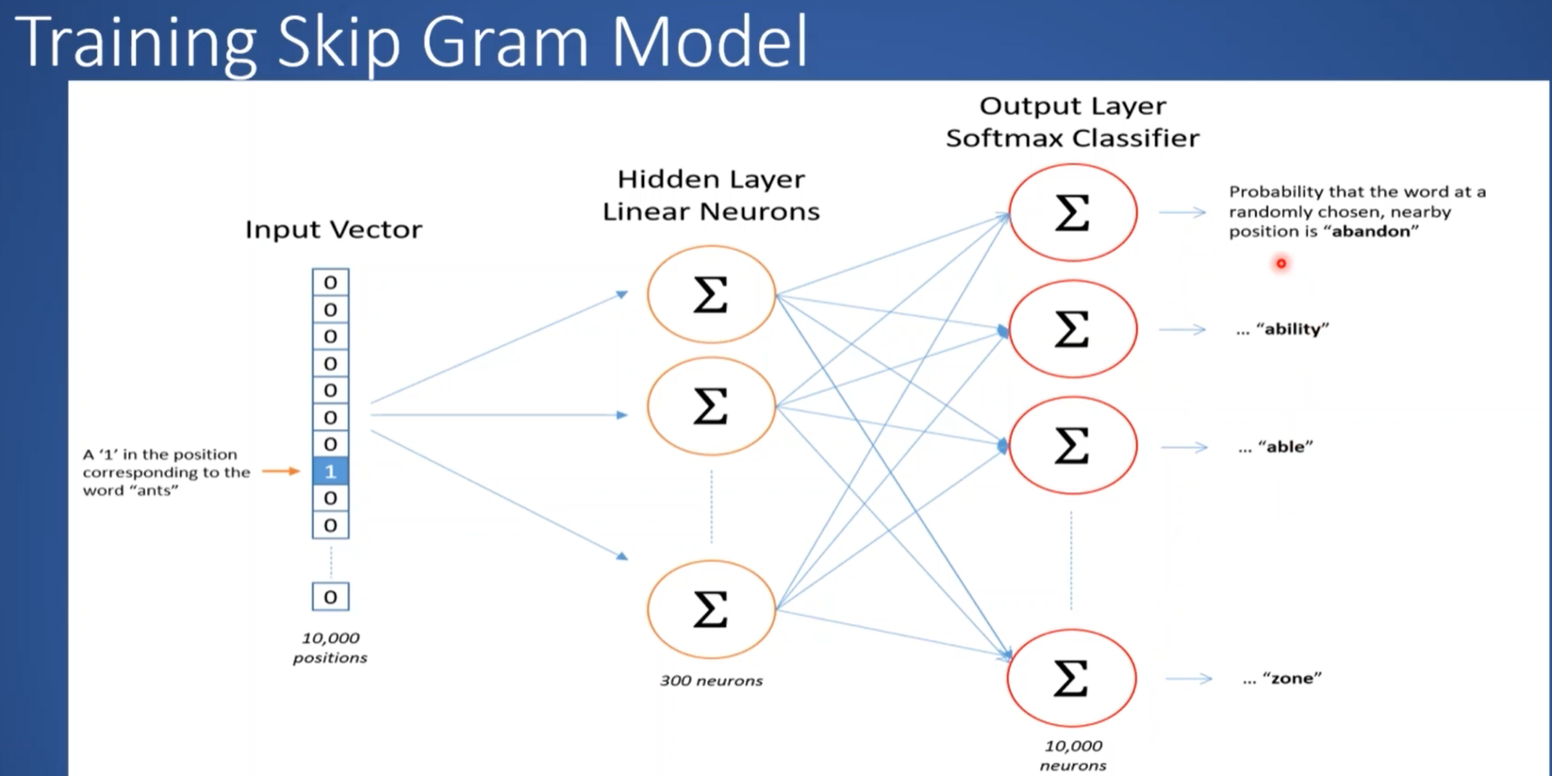
Notes:
This is what a “Neural Network.” looks like used to train a model notice that there are:
At the extreme left 10,000 “Input Vectors” which is the “Input Word” and is represented by 10,000 positions along the “Input Vector.”
That is, the position of the row within the column with the number “1” represents a single “Input Word” in the vocabulary.
In the single “Input Vector” word “Column”, one finds the number “1”, and the location of that row represents that word’s location in the “Input Vector” space,
To its right lies a column of 300 Neurons in the “Hidden Layer” of the “Neural Network”,
And to the right of the “Hidden Layer” are the 10,000 Neurons of the “Output Layer” which “holds” the predicted probability that the “Word” in the “Input Layer” has a position near the “Target Word” in the middle of the “Window” in the sentence being analyzed by the “N-Gram Model.”

Slide 13
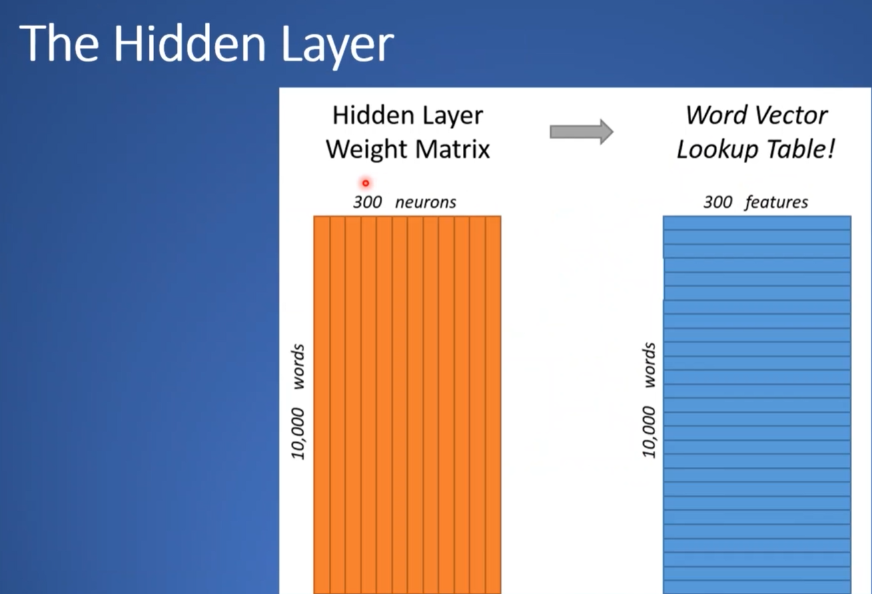
Notes:
This is how a “Hidden Layer” is mapped to a “Lookup Table” which has 300 “features” for each “word vector” based on the neurons of the “Hidden Layer.”

Slide 14
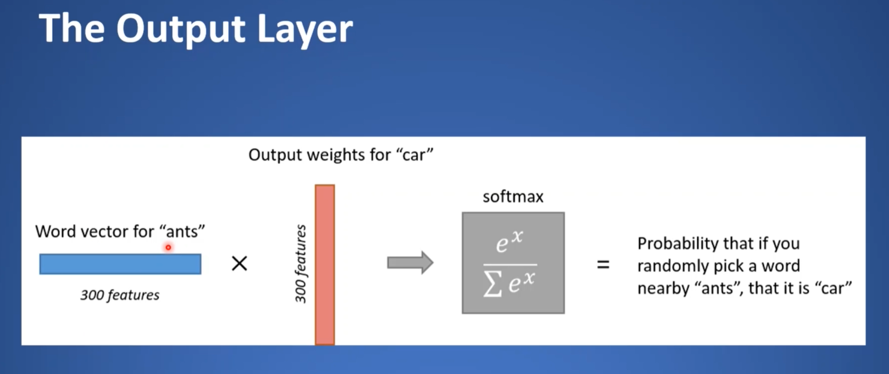
Notes:
This is an example of how the “Input” value for the word “ant” is exposed to “weights” for the word “car” which results in 300 times 300 or 90,000 probabilities which are summed up using the SoftMax function to give the probability that the word “car” is located near the word “ant”.
Example
So, we can think of probability as “closeness of location” of two words as being their measure of relatedness,
Let's say the software randomly picks the word “car” and it has a probability of 0.3 in relation to the location of the word “ant”
Then the software picks the word “hill” whose probability is 0.6,
Then we can say that the word “hill” is more likely to be located near the word “ant” than the word “car” in a sentence’’
We can thereby now say that the word “hill” is more closely related to the word “ant” than the word “car” and so forth...

Slide 15
Information Entropy Rules
“Entropy, as a measure of information content and complexity, was first introduced by Shannon (1948).”
“Topological entropy has been one of the most difficult to implement ‘in’ high-dimensionality problems. ”
The Biological Analogy to Language Processing and Translation
However in Colosimo and de Luca (2000), it is found that the complexity of randomly produced sequences is higher than that of DNA sequences, a result one would expect given the commonly held notion that intron regions of DNA are free from selective pressure and so evolve more randomly than do exon regions.
Colosimo A., de Luca A. Special factors in biological strings, J. Theor. Biol., 2000, vol. 204 (pg. 29-46)
Koslicki, D. Bioinformatics, Volume 27, Issue 8, 15 April 2011, Pages 1061–1067
Shannon C.E. A Mathematical theory of communication, Bell Syst. Tech. J., 1948, vol. 27 (pg. 379-423)
Notes:
Entropy Rules
In Informatics, randomness is associated with noise and order is associated with “Informational Content” and meaning.
Entropy is a measure of information content and complexity in complex systems
In this example, a Biological Analogy is drawn to demonstrate Entropy with the analogy being drawn to the Intronic and Exonic sequences of DNA. The Exonic region of the DNA is exposed to selective evolutionary pressure which acts as an external force to control the effect of a drift toward randomness and maintains the order or sequence integrity of the DNA’s Exonic regions.

Slide 16
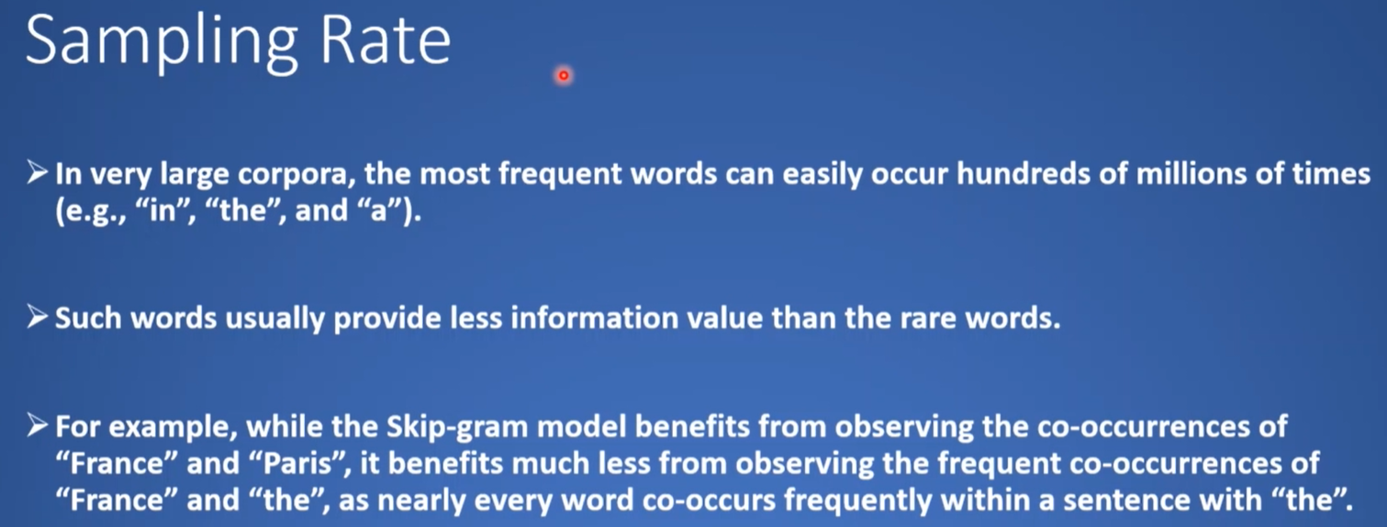
Remember to Remove Stop Words
Notes:
Stop words are words like “in”, “at”, “the”, “of”, “about”, and “a” which even though are grammatically necessary and are frequent in documents and don’t contribute to the “Entropy” of the document.
Rare words especially in their co-occurance on the other hand provide much more information such as in the example in bullet point three in this document.

Slide 17
Negativity and Machine Learning
Or, mixing randomness with order
Notes:
Negativity – can be useful…
In information theory order in the vicinity of randomness, that is, “injecting certainty” into a random system increases the accuracy of a prediction by lowering the Entropy of the system
Since Entropy is the average level of "surprise", or "uncertainty" inherent to the variable's possible outcomes.
This is evident in the next slide

Slide 18
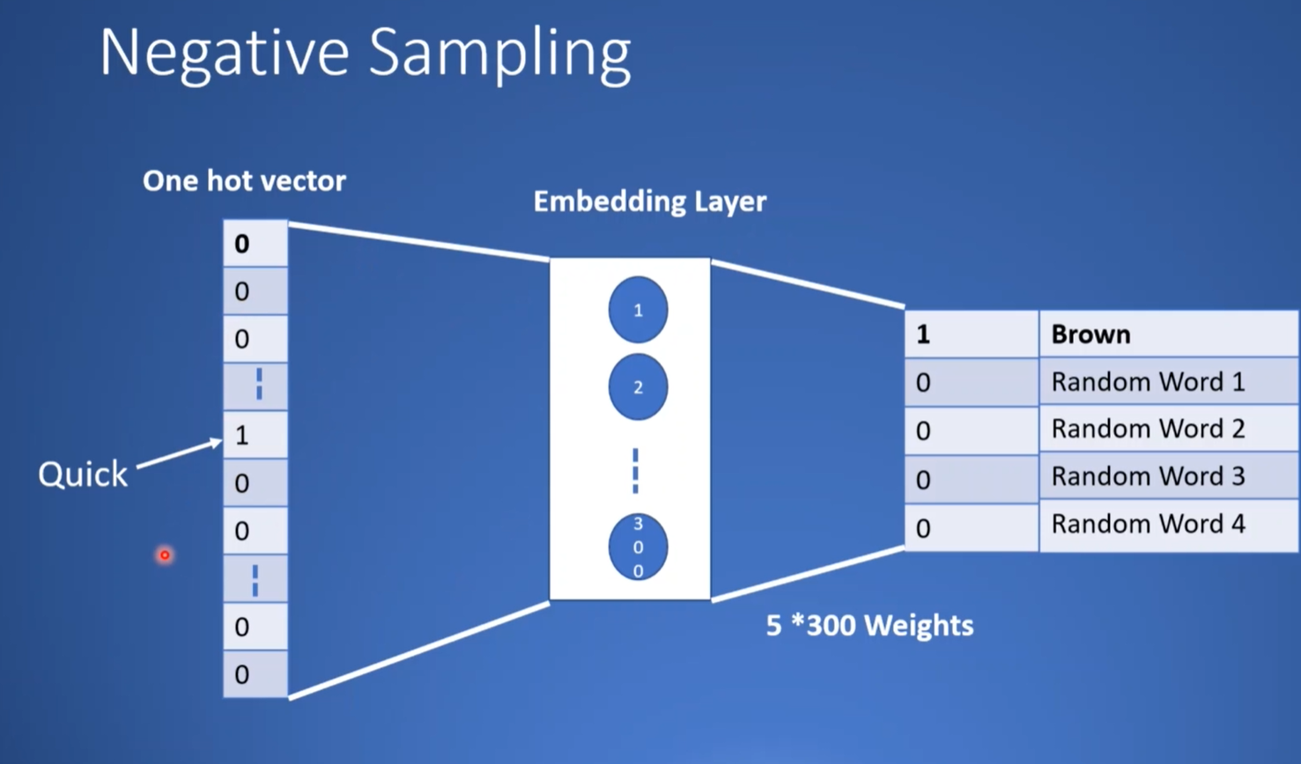
Notes:
In this example the software already knows that the word “Brown” frequently appears near the position in the “Vector Space” of the word “Quick”.
Next, after the removal of “Stop Words” the software creates “Negative Samples” which are words that appear infrequently near the position of the word “Brown” in the “Vector Space”
These Negative Samples are then used as the “Random Words” chosen to accompany the word “Brown” as occupants of the “Output Layer”
What occurs next is that series of “Random Words” where the number is determined by the size of the “Window” (N-value) chosen for the “Outer Layer” are plugged into the “Output Layer” followed by a series of “Iterations” called “Epochs” in the Python programming language are performed with new sets of “Random Words” and their “Probabilities” of being in the vicinity of the word “Brown” are calculated in the “Output Layer” and used to change the scoring matrix of the “Hidden Layer”.
This is the “Machine Learning” process where the system learns from observing the output in the “Outer Layer” and using that output to re-calibrate the scoring values in the “Hidden Layer”.
The software compares these probabilities and derives which one of these words has the highest probability of being in the vicinity of the word Brown and this process is repeated over and over till the most probable words are chosen to constitute our sentence.

Slide 19
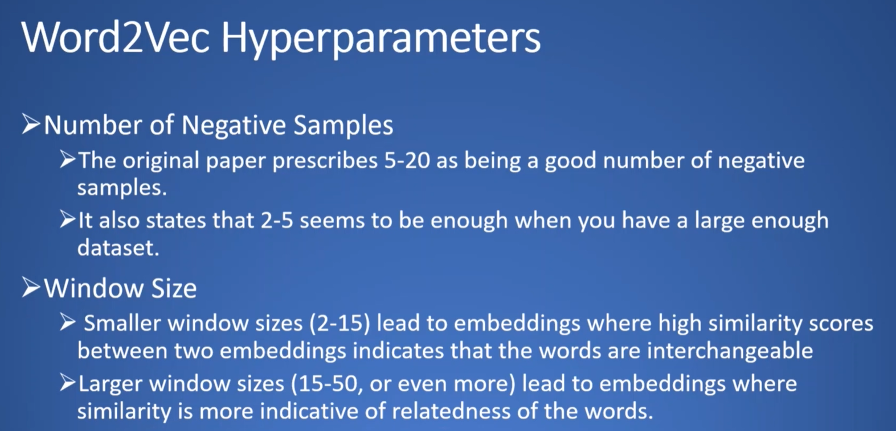
Notes:
This is how you fine tune the Word2Vec Process
Tune the “Number” of “Negative Samples” depending on the size of the dataset
Tune the “Window Size” (N-value) “Smaller” is indicative of “Interchangeability” and “Larger” is indicative of “Relatedness”

Slide 20
Examples
Notes:
The following are actual examples of a Word2Vec program called a library written in the Python programming language running code on an actual Machine Learning model.

Slide 21
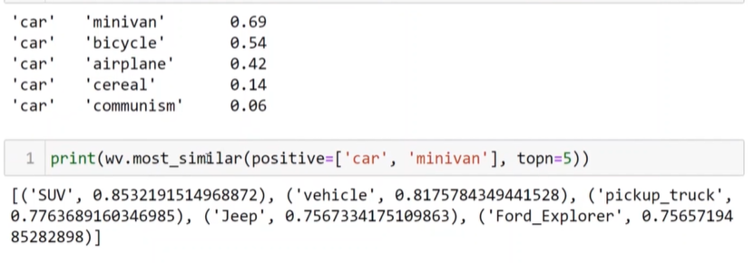
Notes:
Here the software computes the similarity of a variety of words to the word “car” and displays those similarities by percentage
Next, the software prints the “top five words” in its vocabulary that have similarities to the words “car” and “minivan”
The results of both examples can be seen on this slide.

Slide 22
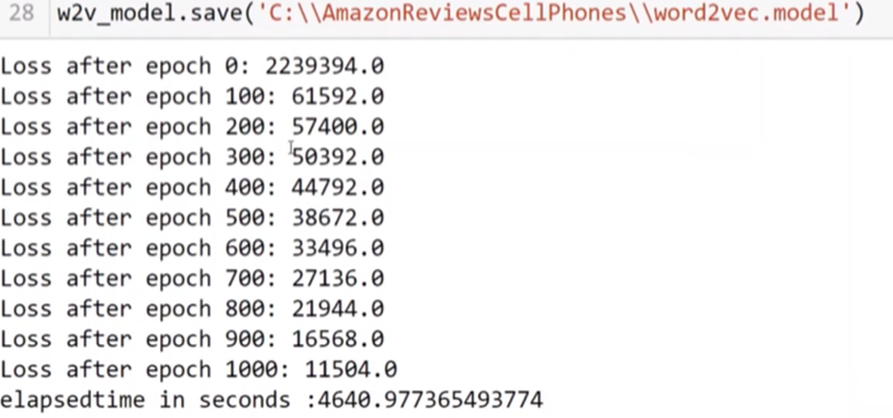
Notes:
Loss is the amount of error present in the prediction as the Machine Learning model is trained and in Epoch zero the amount of loss is high, and by Epoch 1000 the loss is relatively low and is beginning to stabilize which is when we stop training the model.
Please note that with very complex Machine Learning problem processes like this Epoch generation can run for days and even weeks depending on the type (CPU, GPU, TPU) and power (number of processors and RAM) of the computer(s) being used to run the code.

Slide 23
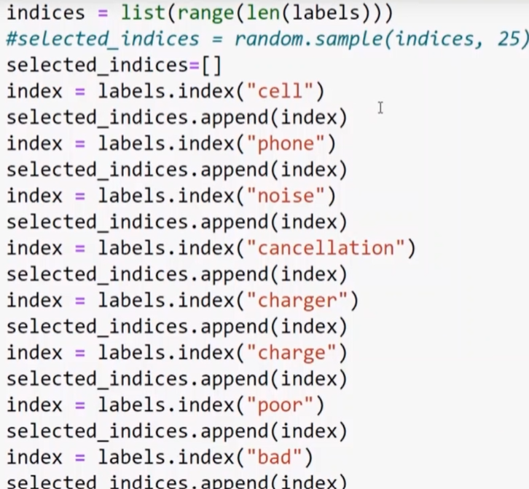
Notes:
This is Python code which will demonstrate the relationship of these eight words (by clustering) relative to the full vocabulary of approximately 30,000 words.

Slide 24
Nirvana
Notes:
According to the Oxford dictionary Nirvana is a state of perfect happiness; or an ideal or idyllic place which is exactly how I feel when I see tens of thousands of data points perfectly aligned and clustered in multi-dimensional space.

Slide 25
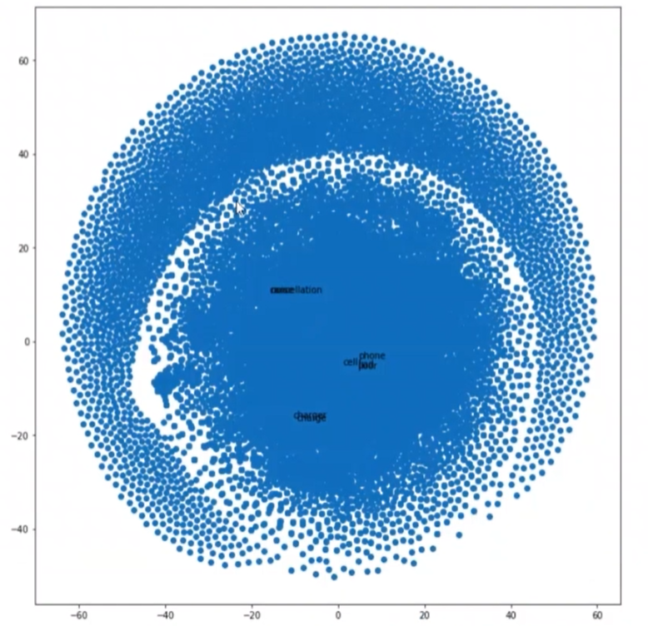
Notes:
This is the output from the Python code showing our eight words clustered within a subcluster of the full vocabulary of approximately 30,000 words.

Slide 26
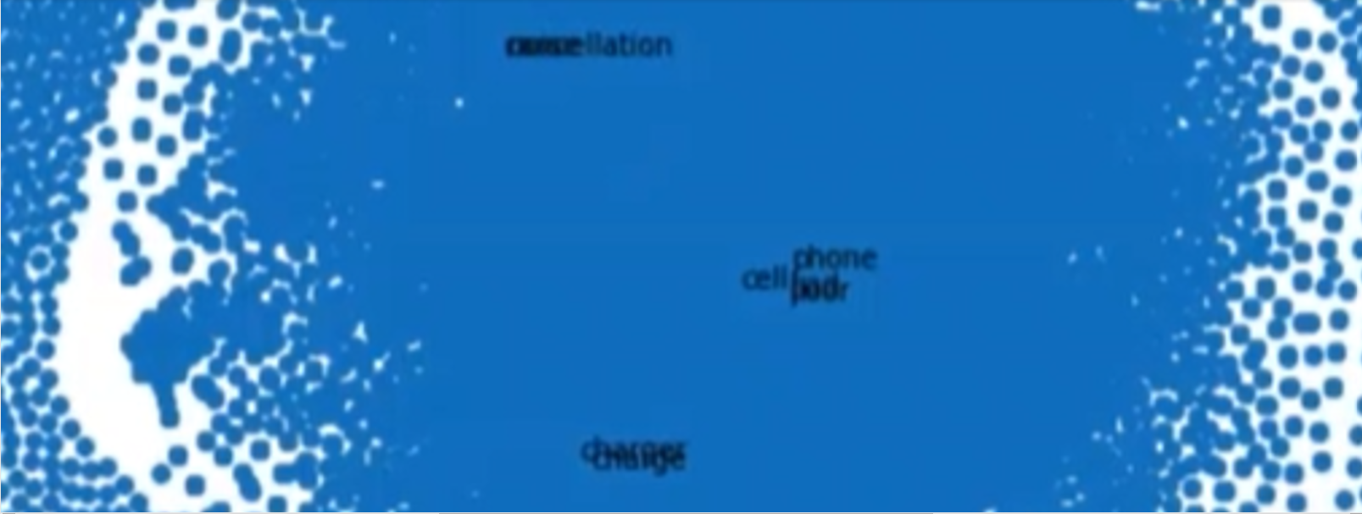
I Might Not Look Like Much, but Looks can be Deceptive
Notes:
This is an enlargement of the previous slide showing our eight words clustered into three distinct clusters with the words “cell” and “phone” clearly visible in the middle cluster.
This example may not seem like much, but this methodology is the same that is used by drug companies to analyze tens of thousands of published papers looking for drugs that are new possible substitutes from known drugs so that they can license new uses for known drugs and continue to profit even from off patent drugs.
Similarly, this methodology is also used by material scientist working for chemical companies looking for new substances to test as possible replacements for old substances. This methodology significantly shortens the list of substances to test when trying to create for example cheaper, and more ecologically friendly batteries.

Slide 27
The End
Notes:
The End

Slide 28
Questions?
Notes:
Questions?

